Slide 1
Blood Typing Based on Image Processing
By: Sameer Zulfiqar and Nghia Luu

Slide 2
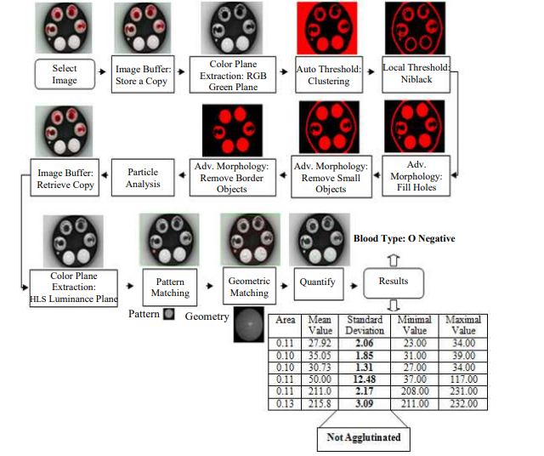
Intro/Background & Research Question
Problem: Trying to determine blood types for blood transfusions in certain emergency situations and time constraints, many people can get an unwanted reaction making it incompatible.
Solution: Develop a prototype able to automatically perform the pre-transfusion tests necessary for a safe blood transfusion in a timely manner.
Q2: What are the steps associated for the prototype algorithm?
Research Question:
Q1: How can the prototype algorithm safely handle blood transfusions and process images according to phenotyping determination and blood typing?
Methods
The phenotyping determination is obtained through image processing techniques applied to the target image.
The plate test method was employed due to its reliability and fast response time suitable in emergency situations as it can be costly and complex.
An algorithm was developed using IMAQ Vision software from National Instruments

Slide 3
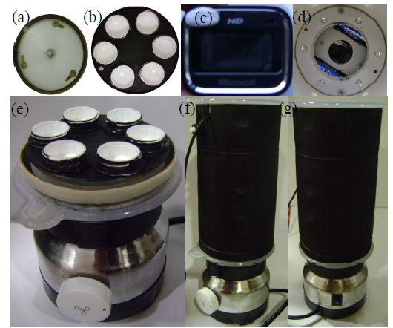
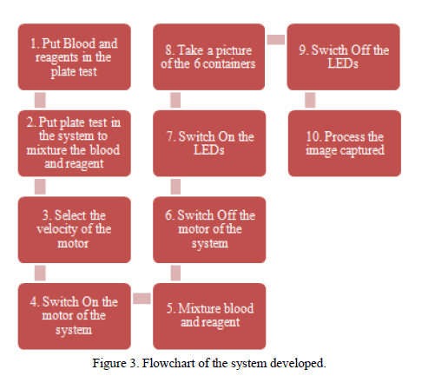
System Features
A methodology was developed regarding the pre-transfusion tests for determining the ABO and Rh type, based on the plate test and image processing techniques.
The proposed system was developed to automatically determine the human blood type of a patient (phenotyping and ABO-Rh).
It has a portable size you can take anywhere with an AC motor with an adjustable rotational speed, centrifuging six containers at once.
Figure 2. Portable System developed: (a) base of the system where piece with containers fits into the system, (b) piece with containers for mixture of blood and reagents, (c) web camera used to capture the image, (d) LEDs around and web camera in the centre, (e) base of the system that promote the mixture, (f) final system with button to change velocity, (g) final system with switch to switch on/off the system.

Slide 4
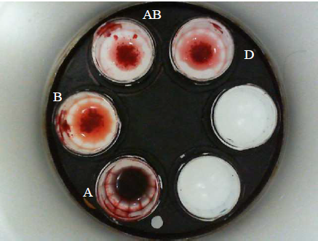
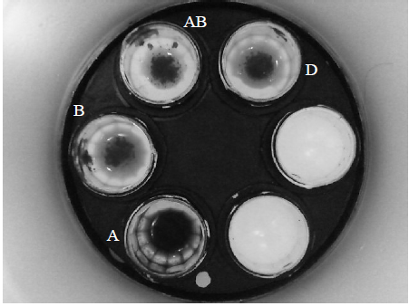
Data Collection
Image 1: This is the blood reagent shown for finding ABO and Rh blood types
Image 2: Results of the application of the developed algorithm through image 1

Slide 5
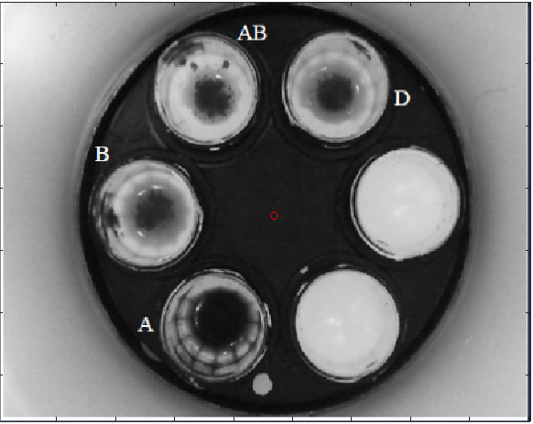
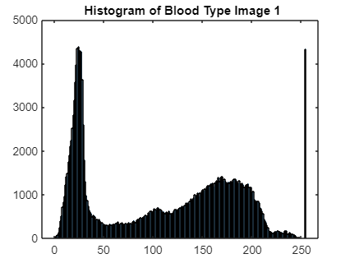
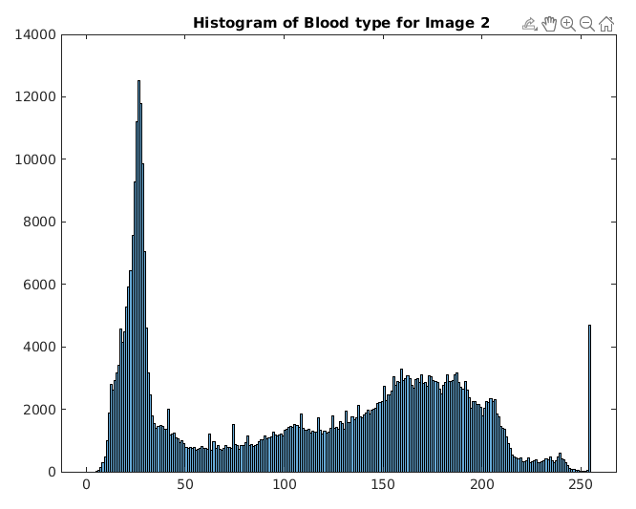
Data Analysis
Mean: 110.7509
Median: 122
Standard Deviation: 70.6874
Mass: 65074470
Critical Mass: 1020000
Center of Mass: (234.5181, 172.4753)
Agglutination: B, AB, D (Rh)
Mean: 109.9080
Median: 121
Standard Deviation: 72.7484
Mass: 30095100
Critical Mass: 765000
Center of Mass: (151.191, 132.2201)

Slide 6
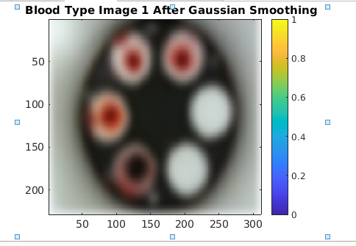
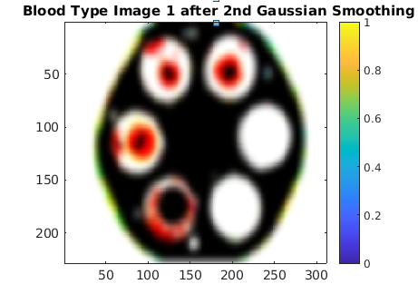
General Findings: Gaussian Smoothing of Image 1

Slide 7
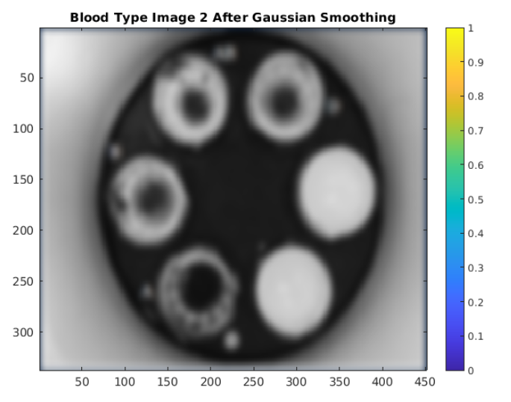
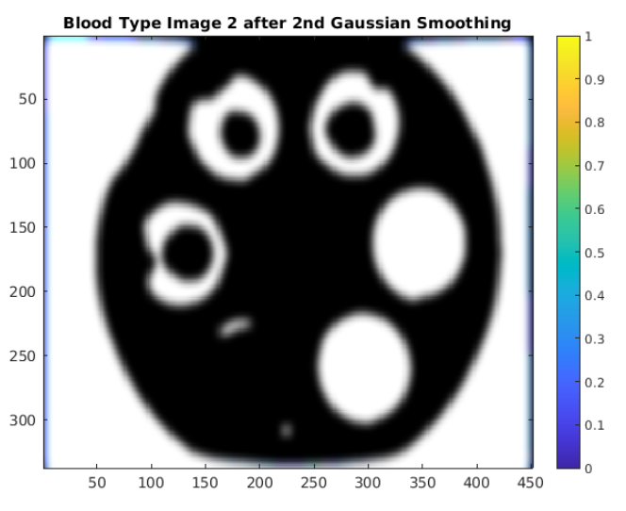
General Findings: Gaussian Smoothing of Image 2

Slide 8
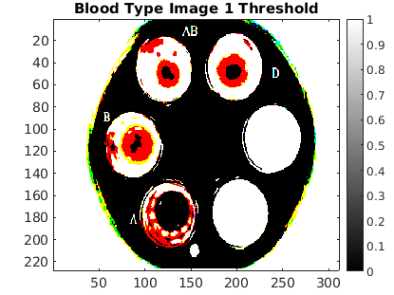
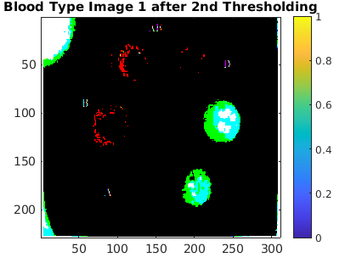
General Findings: Threshold of Image 1

Slide 9
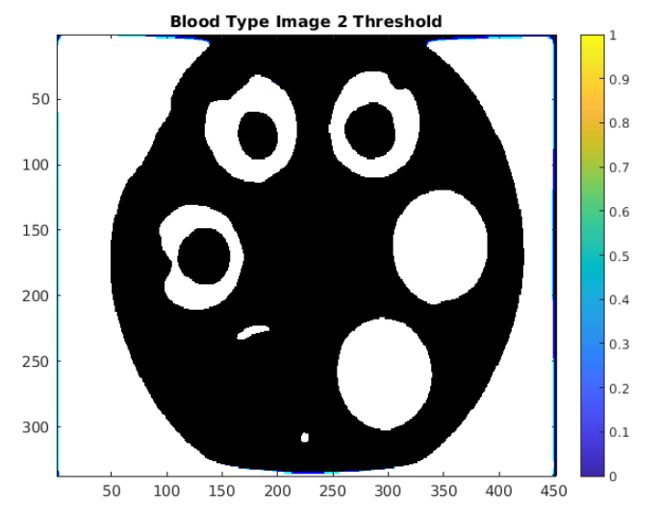
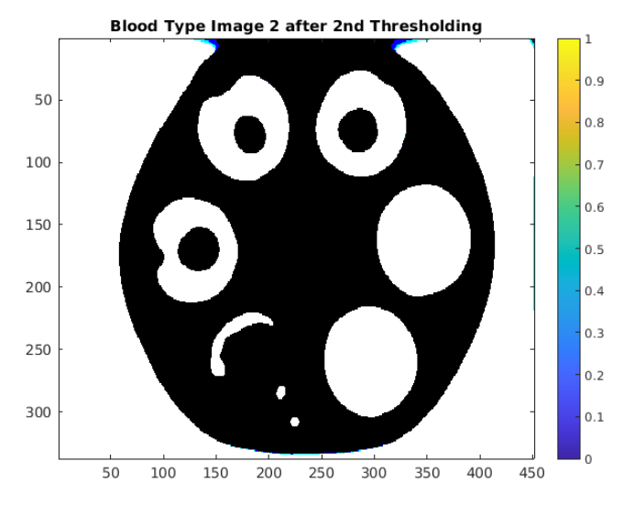
General Findings: Threshold of Image 2

Slide 10
Summary/ conclusion
This experiment allows enforcing the validation of the use of the plate test and image processing techniques as a feasible methodology to blood typing.
Even if it is weak, the image processing techniques developed allow a correct automatic detection of agglutination.
Advantage of the method: short time (5 mins), low cost, and being portable.
The system can be either used for dual operation, mixture (low speed) and centrifuging (high speed), depending of the motor velocity selected.
Reference: SENSORDEVICES 2013 : The Fourth International Conference on Sensor Device Technologies and Applications

